Slide 1
How to keep your bait warm.
Grand Lodge of Georgia

Slide 2
Define Your Organization
MISSION
VISION
CULTURE
PROGRAMS

Slide 3
Define Your Organization
MISSION
THE COMMAND OF THE IOOF IS TO “VISIT THE SICK, RELIEVE THE DISTRESSED, BURY THE DEAD AND EDUCATE THE ORPHAN”

Slide 4
Define Your Organization
VISION
A vision statement is something that specifically relates to your lodge
A vision statement needs programs that are measureable
Does your Lodge have a Vision Statement?
i.e.
Elevate the Character of Man

Slide 5
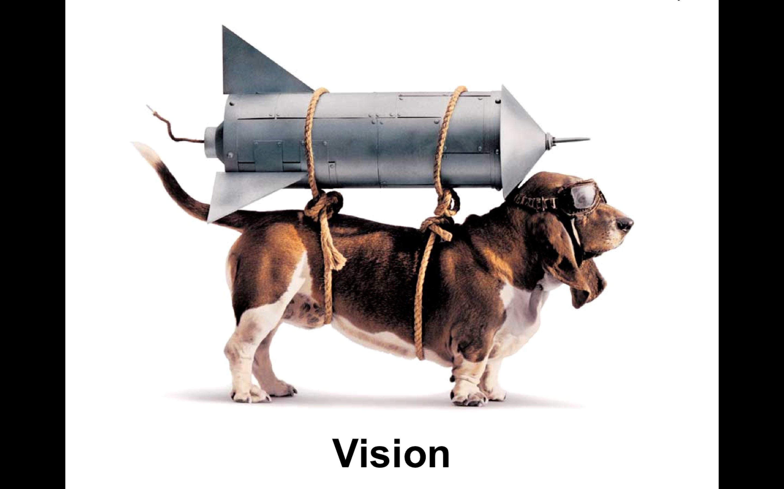

Slide 6
What is Our Culture
What is Culture
  How our Lodge operates
    How we act
    How we react
    How we communicate
    How things get done
    How we solve problems
    Our standards
    Our values
  Remember ~ Leaders Shape the Culture

Slide 7
What is Our Culture
A healthy culture attracts healthy people
  Remember, you attract what you are, not what you want
The opposite is true, unhealthy cultures repel healthy people
  Drama
  Defensiveness
  Self focused
  Sideways energy; stuff is happening but nothing is getting done
  Please see ioofga.com, Links, Grand Lodge Training for more information on Culture.

Slide 8
What is Change and what does it mean to Me
SO WHAT DO I CHANGE, TO KEEP MY BAIT WARM?

Slide 9
What is Change and what does it mean to Me
Be accountable to the MISSION
Define your VISION
Identify your CULTURE
Develop adaptable PROGRAMS

Slide 10
What is Change and what does it mean to Me
The marketplace understands change
  If people don’t buy your product you stop selling it or market it differently.
  DON’T BLAME THE CUSTOMER
  Find the customer’s need and fill it.

Slide 11
What is Change and what does it mean to Me
Why is change scary?
  We usually believe change means loss
  Change requires me to do something different
    Don’t know what to do
    Don’t know how to do it
    Change takes me out of my comfort zone and I don’t want to do it.

Slide 12
What is Change and what does it mean to Me
Just because that’s the way we always did it, does not mean that’s the best way to do it now
Nothing should be off limits to debate, because that will limit your growth

Slide 13
What is Change and what does it mean to Me
When it comes to change “Focus on what you want to gain, not on what you might lose”

Slide 14
What is Change and what does it mean to Me
Stay in love and be loyal to the mission and vision because they don’t change
Programs must change
Programs are ways to serve people and attract them to IOOF membership
  Not all programs work with everyone
  Must have a variety of programs to appeal to diverse needs

Slide 15
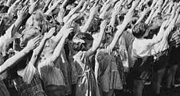
Hitler Youth?

Slide 16
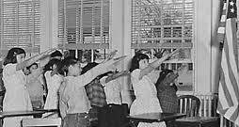
Bellamy Salute,1892 or The Pledge of Allegiance by Francis Bellamy a Christian Socialist. Change to hand over heart in 1942

Slide 17


Slide 18
Generations
Traditionalists 1901-1943
Baby Boomers 1944 - 1964
Generation Xers 1965 - 1981
Millennials 1982 - 2003

Slide 19
Activities of the Lodge
Why should Lodges have Activities?
  Increase fellowship
  Increase membership
  Create more interesting meetings
  Members want to attend when there is a purpose
  Helps to invite people to check out your lodge
  Regain your Lodge purpose to elevate the character of man

Slide 20
Activities of the Lodge
How do we start Activities that people would like to attend?
  Choose activities that are:
    In line with your vision statement
    Interesting to all members
    Diverse to all members
    More than one activity to allow everyone's interest to be engaged
    Don't reinvent the wheel, look for activities that are already established

Slide 21
Activities of the Lodge
What kind of activities could our Lodge start?
Activities:
  Audubon Society
  Bible Study
  Card Group
  Motorcycle Group
  Camping Group
  Movie Night
  Dinner Night
Support a:
  Boy Scout Group
  United Nations Pilgrimage
  Mission Trip
  Student with a Scholarship
  Feed the Homeless
  Salvation Army Drive
  Relay for Life (Cancer Society)
*Remember these are just suggestions*
Have a planning meeting and try one of these ideas or start your own activities.

Slide 22
The Take Away
The best way to find out if things are going well is to ask yourself this question:
WHAT’S THE BEST WAY TO___________________?

Slide 23


